Slide 1
AI Renovation
Group A21
Damian Lopez, Istiak Mohammad, Ahmad Ahmad, Talha Bhatti, Lewis Babila

Slide 2
The Problem
Our Solution
The issue of small properties in Hong Kong is widespread with over 220,000 people living in subdivided flats.
With waiting times for public housing reaching 6-7 years, residents including families have no option but to stay in these small quarters with little organisation, posing multiple safety risks, against the goals of UN SDG 11.7
AI Renovation: An app that allows individuals of low incomes that are situated in Hong Kong to maximize space where they live without high fees, whilst using sustainable materials such as wood, aligning with UN SDG 11.

Slide 3
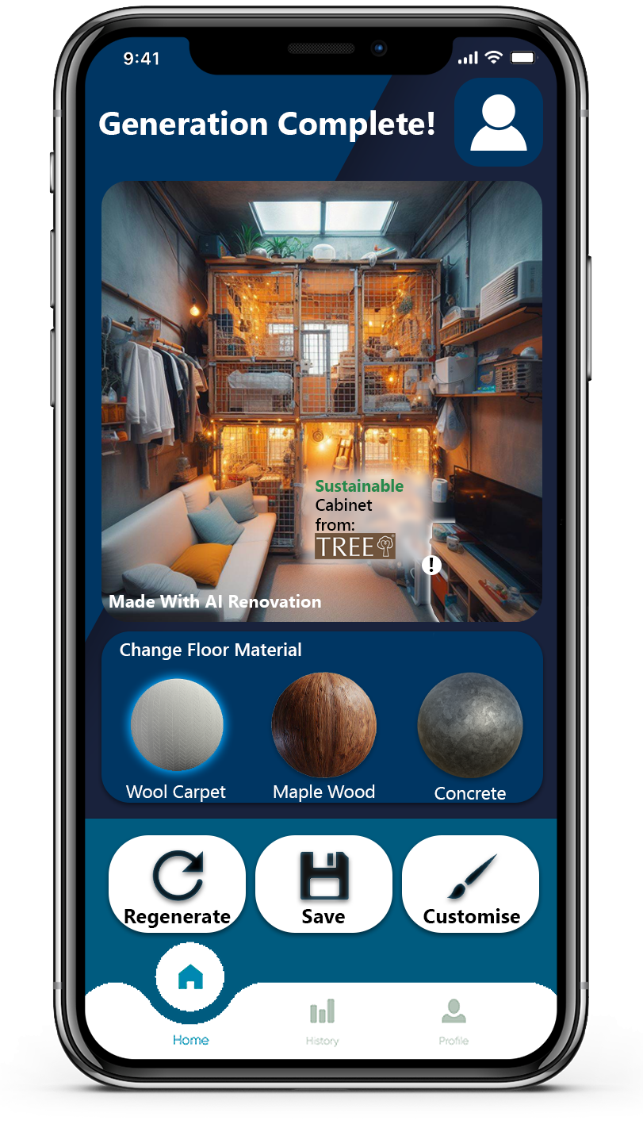
Our Methods
The App
Our app will work by our customer signing up and choosing a subscription package which best suits their needs (Free subscription or Premium subscription).
The user then uploads a picture of their apartment to the app, which is then processed by an AI image generator factoring in sustainable choices and maximizing space
The customer is given an image sent back to them of their apartment, newly and improved, utilising sustainable furniture choices from local suppliers like TREE HK.

Slide 4
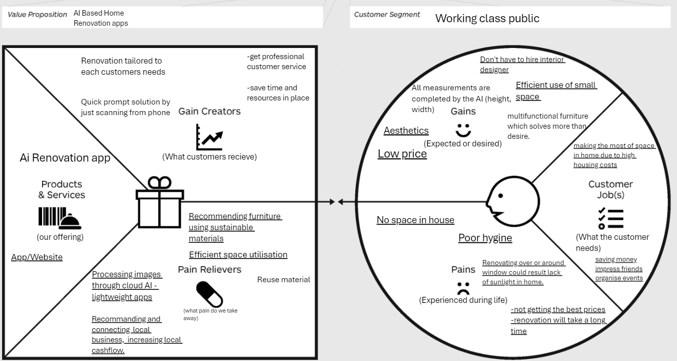
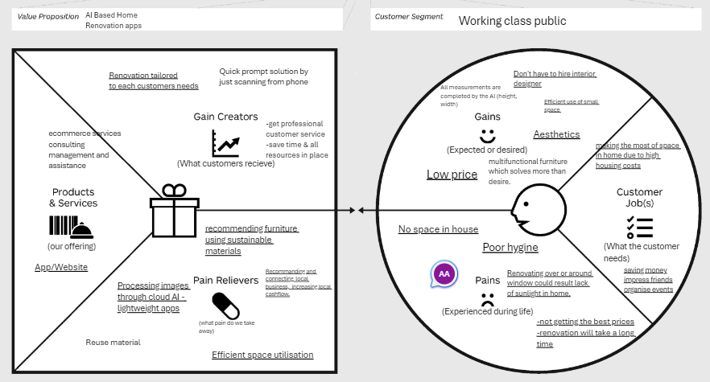
Value Proposition Canvas

Slide 5
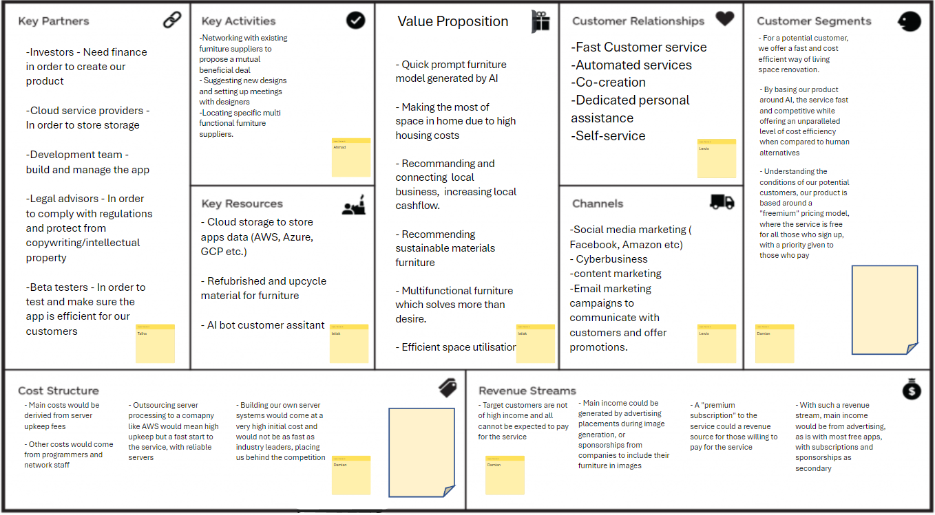
Business Model Canvas

Slide 6
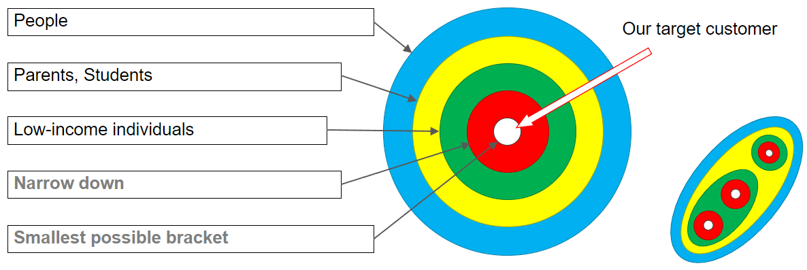
Target Audience
Anyone in HK living in small properties
Families who wish to maximize their space
Low-income individuals
Ease of access via app
Low-income HK residents wishing to maximize space without extortionate fees or a long waiting process with an app

Slide 7
Competitor Analysis
Competitor​ | OUR IDEA | Interior designers ​ | PRH(public rental housing)​ | Soco​ | Remodel AI​ | Room AI​
Benefits To Customer​ | Gives sustainable suggestions on reorganising space​ ​ Trained to use sustainable materials ​ Images generated based on actual space | Provides customers with all kinds of designs to choose from or they offer customers to customise according to their requirements.​ | These properties are provided by the government to low-income households.​ | Home Modification scheme: connects people with professional social workers and architects​ ​ Society is focused on activism for those in poor living conditions in HK, not for monetary gain​ | Home redesigning model within apps by smartphone.​ Low data usage as model generation happens on server side.​​ | -Redesigns pictures and aesthetics of furniture to desired prompt.​ - Enhanced guest satisfaction​
​ Company Type | Private​ | Private​ | Government​ | Society​ | Private​ ​ | Private​
​ Ease of access​ ​ | App/website​ | Must be contacted through email or from their office.​ | Personal information related to income must be sent check eligibility | Only accessible in person or over phone​ | App | Web​
Possible flaws​ ​ ​ | -Waiting time may be high due to high potential interest and enquiries from customers as well as the app just being a start-up business​ | -customers must book costly and long appointments ​ -A long and complicated process involving visits to property ​ | -The waiting time has reached a record of 6 years.​ | -Lack of ease of access​ | -Not web based​ -The model generation takes 10-30s, not quick enough to handle prompt request.​ | -Not App based​ -Limited control​ -Free trial limitation​

Slide 8
Revenue stream:
Advertising
Most income will be generated by advertising placements appearing during image generation.
Subscription
A "premium subscription" to the service will be for those willing to pay for an ad free experience and unlimited image generation
Multi-user:
The highest paid version will be available for enterprise users.
Watermark:
Paid version will have no watermark on the generated picture.
Subscription
A "Free subscription" will have limits on the number of images that can be generated, but a paid version will increase these limits.
Sponsorships
Companies can pay to include their furniture in images as long as it aligns with the goals of the app

Slide 9
Funding Options:
Option | London Tech Week 2024 | Y Combinator | Crowdcube
What kind of idea are they looking for? | IT and technology related business | Technology related business | All ideas
What stage of development? | Developed, Well known | Developed | Well-established, Charge: 2.49% fee on investments
What ‘deal’ are they offering? | To get funded and connect with VCs, CVCs and angel investor | $500,000 for 7% of company share | Easy to use Fully regulated by FCS
Logistics: location, frequency, number of participants, etc | 5000 | 7-10 | 500+
How easy is it to enter? | Easy | Relatively hard | Easy
Overall relevance? | High | Medium | Appropriate
We researched various Startup competitions, Accelerators and Crowd Funding options for
our app,
and have settled on Crowdcube being the most relevant to us due to:
Global reach
Easy of use
Openness to ideas

Slide 10

Thank You For Listening.
References:
1. Time (2022) - 'Cage Homes' in Hong Kong a Stark Reminder of Its Inequities: Accessed 21/03/24
Available: https://time.com/6191786/hong-kong-china-handover-cage-homes
2. UN (2024) - Goal 11 | Department of Economic and Social Affairs:
Accessed 21/03/24
Available: https://sdgs.un.org/goals/goal11

